Slide 1
Today
Lecture 11: Electrodynamics, non-equilibrium superconductivity, and beyond BCS
Discussion the BCS theory in four parts:
Clues to the mechanism and the Cooper instability problem
Attractive interaction and the BCS wavefunction and ground state
Self-consistent solution and quasiparticles
Temperature dependence, thermodynamics, and coherence factors
Electrodynamics, non-equilibrium superconductivity, and beyond BCS
Next time
Lecture 12: Quasiparticle tunneling --- theory

Slide 2
Last time
Used the Bogoliubov quasiparticle operators:
and resulting diagonalized Hamiltonian :
ground state
excitations
to generate thermodynamic properties and the unique coherence factors that arise from pair correlations
Today
(1) Extend to electrodynamics to generate the effect of quasiparticles on the supercurrent
(2) Consider non-equilibrium states induced by perturbations
(3) Give a quick survey of phenomena beyond BCS superconductors

Slide 3
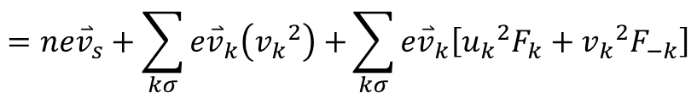

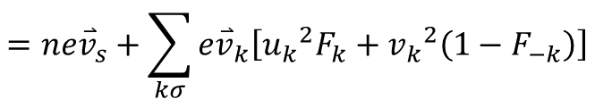


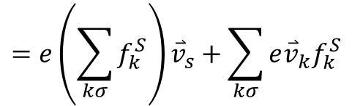
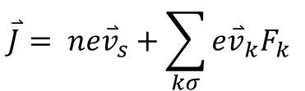


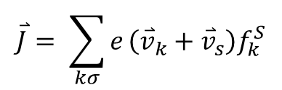



Electrodynamics
$$\frac{n_{s}ev^{2}}{mc} \overset{⃑}{A}$$
London: ${\overset{⃑}{J}}_{s}=n_{s}e{\overset{⃑}{v}}_{s}=$ (supercurrent only)
Rigid wavefunction --- all electrons acquire velocity ${\overset{⃑}{v}}_{s}$
Can allow $n_{s}<n$(in two-fluid or GL picture)
$$\overset{⃑}{J}= \sum_{kσ}{e}\left({\overset{⃑}{v}}_{k}+{\overset{⃑}{v}}_{s}\right)f_{k}^{S}$$
BCS:
$T=0 \overset{⃑}{J}=ne{\overset{⃑}{v}}_{s}$ (no qp’s) $⇒$
$$=e\left(\sum_{kσ}{f_{k}^{S}}\right){\overset{⃑}{v}}_{s}+\sum_{kσ}{e{\overset{⃑}{v}}_{k}f_{k}^{S}}$$
equivalent to pairing between$\left(\overset{⃑}{k}+{\overset{⃑}{k}}_{s}\right)$and
$$\left(−\overset{⃑}{k}+{\overset{⃑}{k}}_{s}\right)$$
$$=ne{\overset{⃑}{v}}_{s}+\sum_{kσ}{e{\overset{⃑}{v}}_{k}\left[{u_{k}}^{2}F_{k}+{v_{k}}^{2}\left(1−F_{−k}\right)\right]}$$
$T>0$QP current term vanishes
$$0$$
if
$$=ne{\overset{⃑}{v}}_{s}+\sum_{kσ}{e{\overset{⃑}{v}}_{k}\left({v_{k}}^{2}\right)+}\sum_{kσ}{e{\overset{⃑}{v}}_{k}\left[{u_{k}}^{2}F_{k}+{v_{k}}^{2}F_{−k}\right]}$$
odd
even
equilibrium Fermi-Dirac distribution
$$\overset{⃑}{J}= ne{\overset{⃑}{v}}_{s}+\sum_{kσ}{e{\overset{⃑}{v}}_{k}F_{k} }$$
diamagnetic
paramagnetic
BUT THIS IS NOT TRUE
$E_{k}$ changed by ${\overset{⃑}{v}}_{s}$
(pairs)
(qp’s)

Slide 4

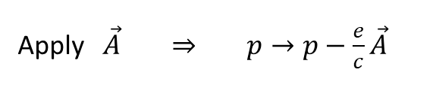
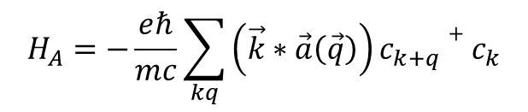
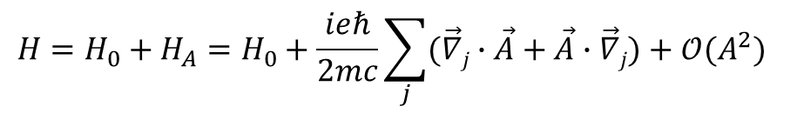
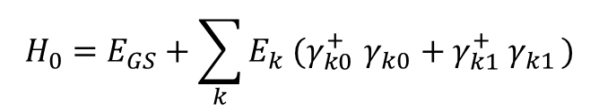
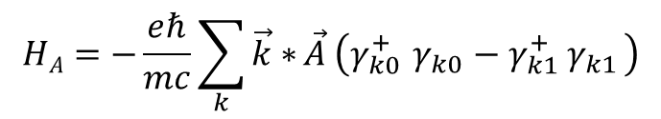
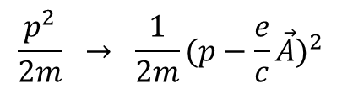


Linear Response Theory
$$\frac{p^{2}}{2m} → \frac{1}{2m}{(p−\frac{e}{c}\vec{A})}^{2}$$
Apply $\vec{A} \overset{⇒}{ } p→p−\frac{e}{c}\vec{A}$
neglect
Fourier Transform
$$H=H_{0}+H_{A}=H_{0}+\frac{ieℏ}{2mc}\sum_{j}{(\vec{∇}j}∙\vec{A}+\vec{A}∙\vec{∇}j)+𝒪(A^{2})$$
$$\vec{A}\left(\vec{r}\right)= \sum_{q}{a(\vec{q}) }e^{i\vec{q}∙\vec{r}}$$
$$H_{A}=−\frac{eℏ}{mc}\sum_{kq}{\left(\vec{k}∗\vec{a}\left(\vec{q}\right)\right)c_{k+q}+c_{k}}$$
$$=−\frac{eℏ}{mc}\sum_{kq}{\vec{k}∗\vec{a}}\left(\vec{q}\right)\left[\left(u_{k}u_{k+q}+v_{k}v_{k+q}\right)\left({{γ_{\left(k+q\right)0}^{+}}_{ }}^{ }γ_{{k0}_{ }}−{γ_{k1}^{+}}^{ }{ γ}_{{\left(k+q\right)1}_{ }}\right)+(v_{k}u_{k+q}−u_{k}v_{k+q})(γ_{\left(k+q\right)0}^{+}γ_{k1}^{+}−γ_{{\left(k+q\right)1}_{ }}γ_{{k0}_{ }})\right]$$
scattering
Type II
coherence factors
creation (pairbreaking)
annihilation
(recombination)
Consider $\vec{q}=0$
$$HA=−\frac{eℏ}{mc}\sum_{k}{\vec{k}∗}\vec{A} \left(γ_{k0}^{+}{ γ}_{{k0}_{ }}−γ_{k1}^{+}{ γ}_{{k1}_{ }}\right)$$
$$H_{0}=E_{GS}+\sum_{k}{E_{k} (γ_{k0}^{+}{ γ}_{{k0}_{ }}+γ_{k1}^{+}{ γ}_{{k1}_{ }})}$$
$$λ$$
--- local regime
long

Slide 5

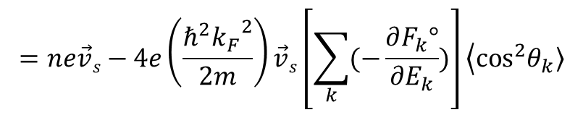
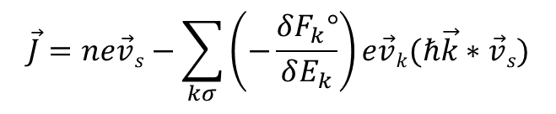

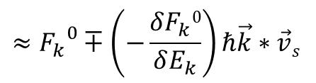
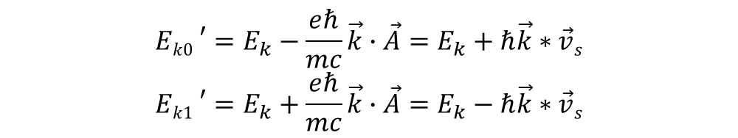
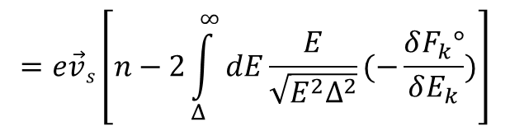
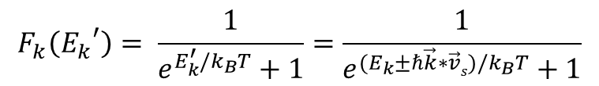

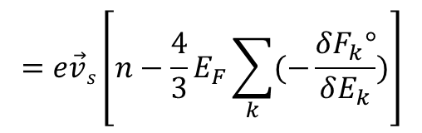
Excitation energies are shifted when $\vec{A}$ applied
$${{Ek0}_{ }}^{′}=E_{k}−\frac{eℏ}{mc}\vec{k}∙\vec{A}=E_{k}+ℏ\vec{k}∗\vec{v}s$$
$${{Ek1}_{ }}^{′}=E_{k}+\frac{eℏ}{mc}\vec{k}∙\vec{A}=E_{k}−ℏ\vec{k}∗\vec{v}s$$
$$\vec{v_{s}}=−\frac{e}{mc}\vec{A}$$
“Doppler Shift”
Return to current $⇒$ breaks symmetry of qp distribution
$$F_{k}\left({E_{k}}^{′}\right)= \frac{1}{e^{E_{k}^{′}/k_{B}T}+1}=\frac{1}{e^{(E_{k}±ℏ\vec{k}∗\vec{v}s)/k_{B}T}+1}$$
$$≈{F_{k}}^{0}∓\left(−\frac{δF_{k}0}{δE_{k}}\right)ℏ\vec{k}∗\vec{v}s$$
$$\vec{J}=ne\vec{v}s−\sum_{{kσ}_{ }}{\left(−\frac{δF_{k}°}{δE_{k}}\right)e\vec{v}k(ℏ\vec{k}∗\vec{v}s)}$$
$$=ne\vec{v}s−4e\left(\frac{ℏ^{2}{k_{F}}^{2}}{2m}\right)\vec{v}s\left[\sum_{k}{(−\frac{∂F_{k}°}{∂E_{k}})}\right]\left\langle \cos^{2}\left.θ_{k}\right\rangle \right.$$
$$=e\vec{v}s\left[n−\frac{4}{3}E_{F}\sum_{k}{(−\frac{δF_{k}°}{δE_{k}})}\right]$$
$$=e\vec{v}s\left[n−2\int_{Δ}^{∞}{dE\frac{E}{\sqrt{E^{2}Δ^{2}}}(−\frac{δF_{k}°}{δE_{k}})}\right]$$
$$≡nse\vec{v}s$$

Slide 6


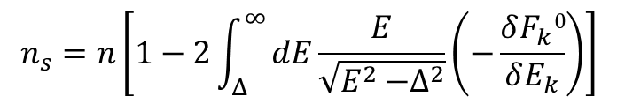


$$n_{s}=n\left[1−2\int_{Δ}^{∞}{dE\frac{E}{\sqrt{E^{2}{−Δ}^{2}}}\left(−\frac{δF_{k}0}{δE_{k}}\right)}\right]$$
no contribution from quasiparticles
$$−\frac{δF_{k}0}{δE_{k}}$$
$$k_{B}T≪Δ$$
$$\frac{E}{\sqrt{E^{2}{−Δ}^{2}}}$$
$$k_{B}T>∆$$
large contribution from quasiparticles
Paramagnetic current (from qp’s) cancels the diamagnetic current (from pairs) at $T=T_{c}$

Slide 7

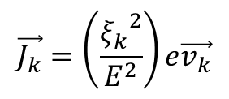

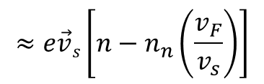

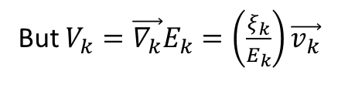
Physical picture
Shifted Fermi sphere
qp’s lower energy by scattering to the backside of Fermi surface
$$\vec{J_{s}}=ne\vec{v}s$$
$$\vec{J_{s}}=ne\vec{v}s−n_{n}ev_{F}$$
$$≈e\vec{v}s\left[n−n_{n}\left(\frac{v_{F}}{v_{s}}\right)\right]$$
(all electrons contribute)
(some electron flow backwards)
backflow term
This is all supercurrent $⇒$ lowers free energy at given T. Not dissipative even though excitations are involved!!!
Current $\sim e\vec{v_{k}}$ carried by each qp
But $V_{k}=\vec{∇_{k}}E_{k}=\left(\frac{ξ_{k}}{E_{k}}\right)\vec{v_{k}}$
$$\vec{J_{k}}=\left(\frac{{ξ_{k}}^{2}}{E^{2}}\right)e\vec{v_{k}}$$
$Q_{k}=(\frac{ξ_{k}}{E_{k}})$ $e$

Slide 8
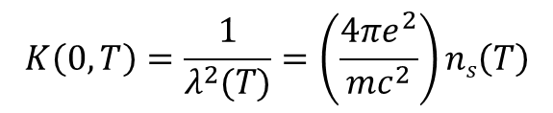


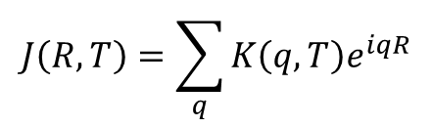

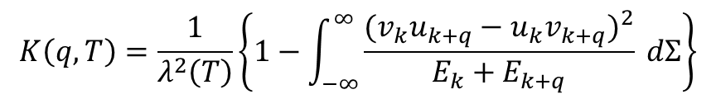

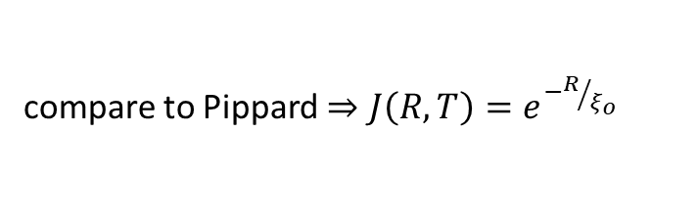


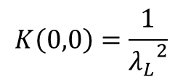

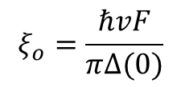
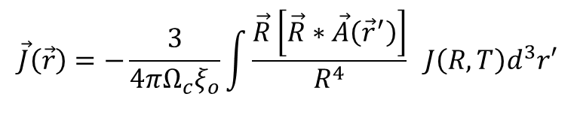
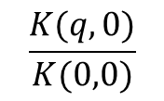
What about $q≠0$ terms? Gives non-locality
London: $\vec{J}\left(\vec{r}\right)=−\frac{c}{4π}\frac{1}{{λ_{L}}^{2}}A\left(\vec{r}\right)=ne\vec{v}s$
$$\vec{J}\left(\vec{r}\right)=\sum_{q}{J\left(q\right){ e}^{i\vec{q}∙\vec{r}}}$$
$$A\left(\vec{r}\right)=\sum_{q}{a\left(q\right){ e}^{i\vec{q}∙\vec{r}}}$$
BCS:
$\vec{J}\left(q\right)=−\frac{c}{4π}K\left(q\right)$ $a\left(q\right)$
$$K\left(0,0\right)=\frac{1}{{λ_{L}}^{2}}$$
$$K\left(0,T\right)=\frac{1}{λ^{2}(T)}=\left(\frac{4πe^{2}}{mc^{2}}\right)ns\left(T\right)$$
BCS Kernal
$$\frac{K(q,0)}{K(0,0)}$$
Real space:
For $q>0$, treat in perturbation theory:
BCS coherence length
$$ξ_{o}=\frac{ℏvF}{πΔ(0)}$$
$$K\left(q,T\right)=\frac{1}{λ^{2}\left(T\right)}\left\{1−\int_{−∞}^{∞}{\frac{({v_{k}u_{k+q}−u_{k}v_{k+q})}^{2}}{E_{k}+E_{k+q}} dΣ}\right\}$$
$$J\left(R,T\right)$$
$$J\left(R,T\right)=\sum_{q}{K\left(q,T\right)e^{iqR}}$$
$$\vec{J}\left(\vec{r}\right)=−\frac{3}{4πΩ_{c}ξ_{o}}\int{\frac{\vec{R}\left[\vec{R}∗\vec{A}\left({\vec{r}}^{′}\right)\right]}{R^{4}}} J\left(R,T\right)d^{3}r′$$
compare to Pippard $⇒J\left(R,T\right)=e^{−R/{ξ_{o}}}$
$$T$$

Slide 9
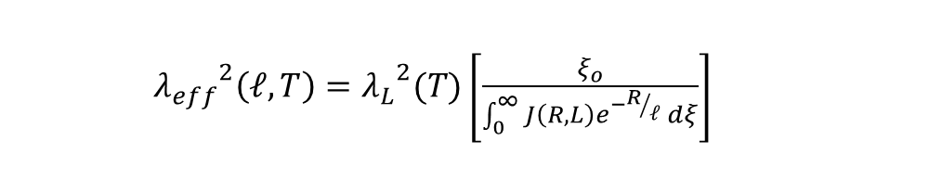
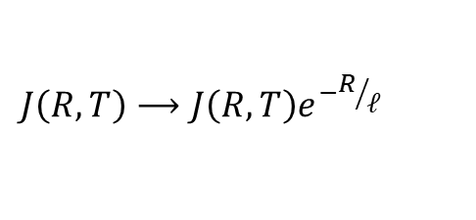
Impurities:
$$J\left(R,T\right)⟶J\left(R,T\right)e^{−R/ℓ}$$
${λ_{eff}}^{2}\left(ℓ,T\right)={λ_{L}}^{2}(T)\left[\frac{ξ_{o}}{\int_{0}^{∞}{J\left(R,L\right)e^{−R/ℓ} dξ}}\right]$
Penetration depth:
BCS does it all and got it (almost) all right !

Slide 10


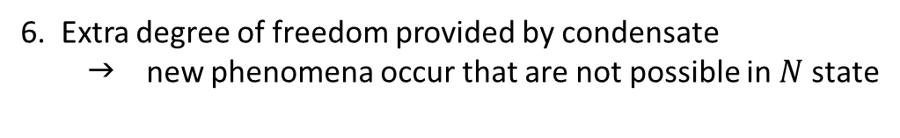

Non-Equilibrium SC
QP’s not in thermal equilibrium: $F_{k}≠{Fk}^{0}=\frac{1}{e^{\frac{E}{kBT}+1}}$
$$F_{k}={Fk}^{0}+G_{k}$$
deviation from equilibrium
Apply perturbation $⇒$ drive system out of equilibrium
Balance rates by the Boltzman equation
Opposed by relaxation to equilibrium by scattering and diffusion
Perturbations
Response – mostly like normal metal except :
E-fields
Temperature gradients
EM fields
Charge injection by transport or tunneling
Phonon injection
supercurrent blocks perturbation of qp’s (shorts out $\overset{⃑}{E}$)
2. energy gap reduces # qp’s at any $T$ $⇒$freeze out at low $T$
DOS large near gap edge $ξ≲∆$
4. QP’s properties modified for $k_{B}T>∆$--- most qp’s way above gap
5. Coherence factors --- effect on scattering events
6. Extra degree of freedom provided by condensate  new phenomena occur that are not possible in $N$ state

Slide 11












symmetry in $ξ_{K}$ and $\overset{⃑}{k}$
OUT-OF-EQUILIBRIUM
EQUILIBRIUM
$$G_{k}$$
$ξ_{K}$ $\overset{⃑}{k}$
$$E$$
CURRENT MODE
EVEN
ODD
(electric field)
$$k_{B}T$$
$$G_{k}$$
$$k$$
$$−kF$$
$$+kF$$
HEAT CURRENT MODE
$$G_{k}=0$$
ODD
ODD
(T gradient)
$$G_{k}$$
No analogue for normal metals:
ENERGY MODE
GAP MODIFICATION
EVEN
EVEN
(excess # of qp’s)
$$G_{k}$$
CHARGE MODE
CHARGE IMBALANCE
ODD
EVEN
(excess charge in qp’s)

Slide 12



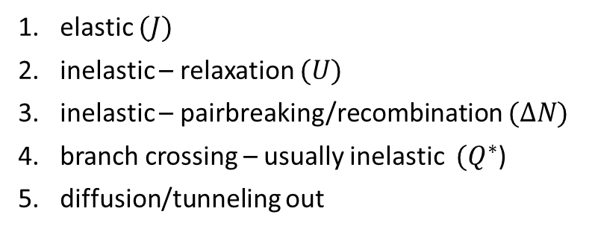






QP Relaxation
$$E_{K}$$
5 processes:
elastic $(J)$
inelastic – relaxation $(U)$
inelastic – pairbreaking/recombination $(ΔN)$
branch crossing – usually inelastic $(Q^{∗}$)
diffusion/tunneling out
$$(1)$$
$$(4)$$
$$(2)$$
$$(3)$$
$$(3)$$
$$0$$
$$kF$$
$$−kF$$
Experiments/devices
Dynamic – pulse perturbation, measure decay in time
DO NOT NEGLECT PHONONS!
Diffusive – inject steady perturbation, measure spatial decay
Steady state – measure out-of-equilibrium distribution
Kinetic equation (Boltzman equation)
QP’s $\frac{dF}{dt}={\left(\frac{∂F}{∂t}\right)}_{\begin{aligned}injection \\ \end{aligned}}+ {\left(\frac{∂F}{∂t}\right)}_{scattering}+ {\left(\frac{∂F}{∂t}\right)}_{diffusion}$
Equations are coupled by electron-phonon scattering and heating
Phonons $\frac{dN_{ω}}{dt}={\left(\frac{∂N_{ω}}{∂t}\right)}_{injection}+ {\left(\frac{∂N_{ω}}{∂t}\right)}_{scattering}+ {\left(\frac{∂N_{ω}}{∂t}\right)}_{diffusion}$

Slide 13
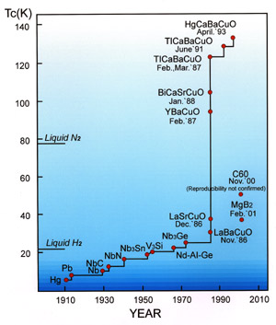
Conventional (“classic”) superconductivity
BCS theory:
Bardeen, Cooper, Schrieffer (1957)
k'
k
1
q
2
-
-
e
e
MECHANISM = attractive phonon-mediated
electron-electron interaction  Cooper pairing
k
1
k'
2
GROUND STATE = superfluid pair condensate
ψ = n_{s} e ^{iϕ}
macroscopic phase coherence
EXCITATIONS = normal “quasiparticles” with an isotropic energy gap
k_{z}
Δ(k) = Δ
23.2K
k_{y}
Liquid He
k_{x}
“s-wave”

Slide 14
BCS gap equation
Weak coupling
If the interaction is isotropic, so is the gap function  same for all quasiparticles independent of $\overset{⃑}{k}$
If the gap is isotropic, scattering doesn’t change the gap seen by the quasiparticles so the $Tc$ should not depend on impurities  Anderson theory
All of this changes if the pairing interaction is not isotropic electron-phonon scattering
There were many attempts to raise $Tc$ by varying all of the parameters in the BCS gap equation $Tc$ AND by proposing other pairing mechanisms --- these were universally unsuccessful.
It was believed by many that all SC’s were BCS, paired by electron-phonon scattering, and were limited to $Tc$ ‘s below ~50K until 1986.

Slide 15
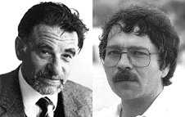
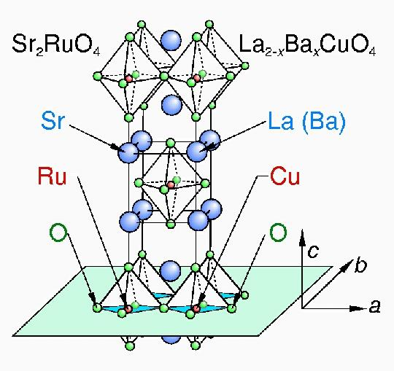


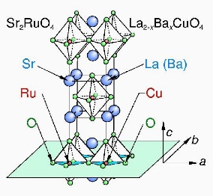
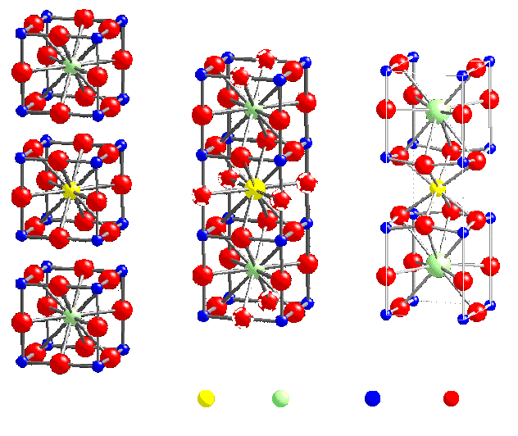
High Temperature Superconductivity (1986)
Alex Müller
Georg Bednorz
IBM Zurich Research Laboratory
La_{2-x}Ba_{x}CuO₄
YBa₂Cu₃O_{7-x}
T_{c} ~ 30K
T_{c} ~ 90K

Slide 16
HTSC --- many unusual properties were discovered in the first few years
Ceramics --- oxide materials, not metals
T_{c} was much higher than could be explained by conventional BCS
H_{c2} was immeasurably large
Layered materials --- low dimensional effects, strong in-plane correlations, anomalous vortices
Unusual properties --- thermodynamics, transport, electrodynamics, … power laws instead of exponential implying that the energy gap was not fully formed
Unusual doping dependence --- complicated phase diagram
T
strange metal
Not-so-normal metal
pseudo-
gap
Mott insulator
super-
conductor
superconductor
electron doping
hole doping
7. UNCONVENTIONAL SUPERCONDUCTIVITY

Slide 17
Unconventional superconductivity
There was almost immediate evidence that the cuprates were “unconventional”
What does “unconventional” mean? Not BCS
  Mechanism other than phonon-mediated pairing
  Symmetry not s-wave … exhibits anisotropy in phase and/or magnitude
⬇
1st indication: UPt₃ (heavy fermion)  two peaks in specific heat
1st confirmation: YBa₂Cu₃O_{7-x} (high-T_{c} superconductor)  d-wave

Slide 18
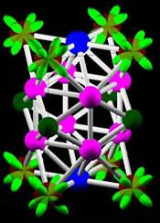
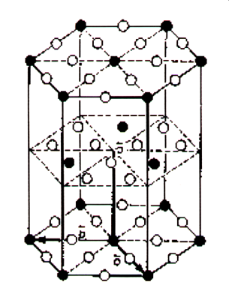
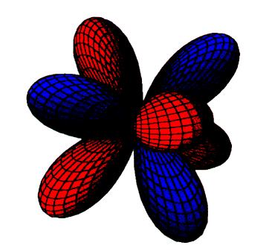
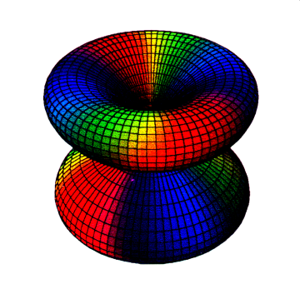
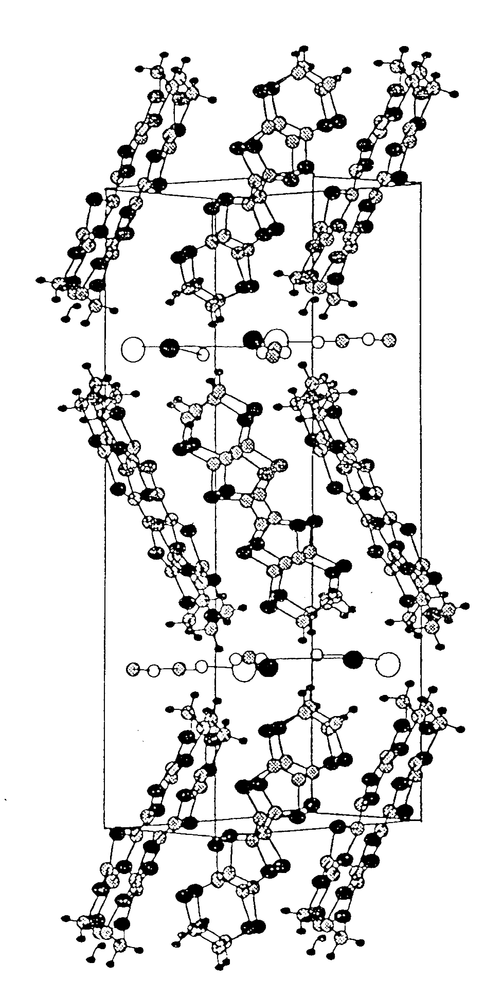
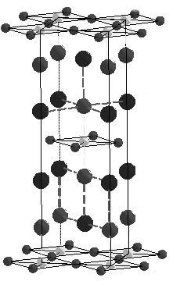
Growing Family of Unconventional Superconductors
Cuprate superconductors
115 superconductors
Organic superconductors
YBa₂Cu₃O_{7-x}
T_{c} = 95K
CeCoIn₅ T_{c} = 2.3K
κ-(BEDT-TTF)₂Cu[N(CN)₂]Br
T_{c} = 11.6K
+
+
_
_
_
_
+
_
_
+
+
+
“d-wave”
“d-wave”
“anisotropic
d-wave”
Ruthenate superconductors
Heavy Fermion superconductors
Sr₂RuO₄ T_{c} = 1.5K
UPt₃ T_{cA} = 0.50 T_{cB} = 0.45K
p_{x}+ip_{y}
(k_{x}²-k_{y}²) k_{z}
(k_{x}+ ik_{y})² k_{z}

Slide 19
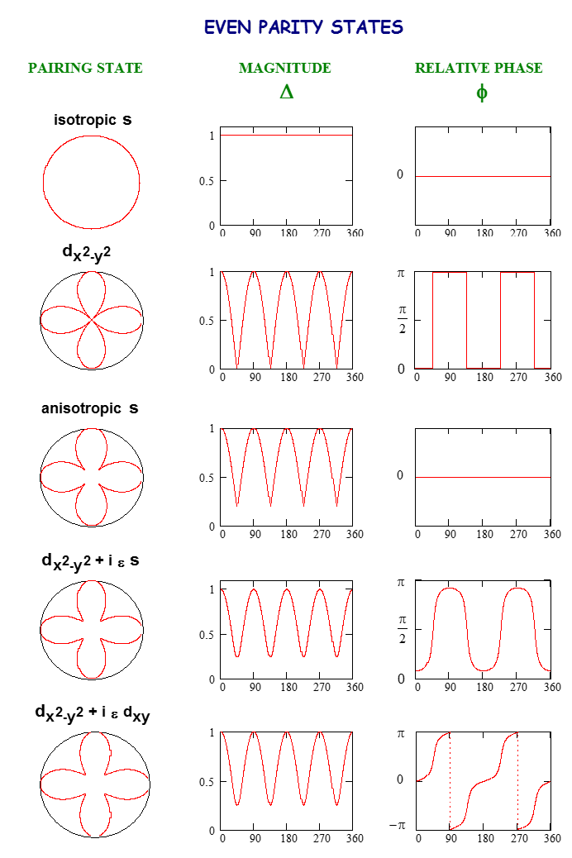


Determining the Pairing Symmetry --- A Roadmap for Experimentalists
Cuprate candidates
s vs. d_{x}²-_{y}²
-
+
+
-
Magnitude measurements
probe quasiparticles --- but can be masked or mimicked by impurities
Phase measurements
give a distinct signature --- less susceptible to microscopic details
θ
θ
Complex order parameter →
broken time-reversal symmetry
phase shift δ ≠ 0, π
θ
θ

Slide 20

Family tree of superconductors
hydrogen sulphide
fullerenes
conventional
pnictides
carbon

Slide 21

Family Tree --- Iron Pnictides
(1111)
(122)
(111)
(11)

Slide 22


Phase diagrams
Order parameter symmetry
s±
1111 family
122 family
Phase-shift of π between different electron bands
Ba(Fe_{1-x}Co_{x})₂As₂

Slide 23
What does this mean for the course?
For quantum information science, not much.
In general, unconventional SC is bad for qubits because of quasiparticles that are not suppressed by a fully-formed energy gap and because of vortices not pinned in Type II superconductors.
Most qubits utilize conventional metallic s-wave superconductors such as Al and Nb.
POSSIBLE EXCEPTION: p-wave superconductors may support Majorana fermion stateas that could offer topological protection from dephasing --- more on this later.
For superconductor device physics, a lot.
Quasiparticle tunneling is an excellent probe of order parameter/energy gap magnitude anisotropy
Josephson tunneling is an excellent probe of order parameter/energy gap phase anisotropy and unconventional superconductivity.

